Slide 1
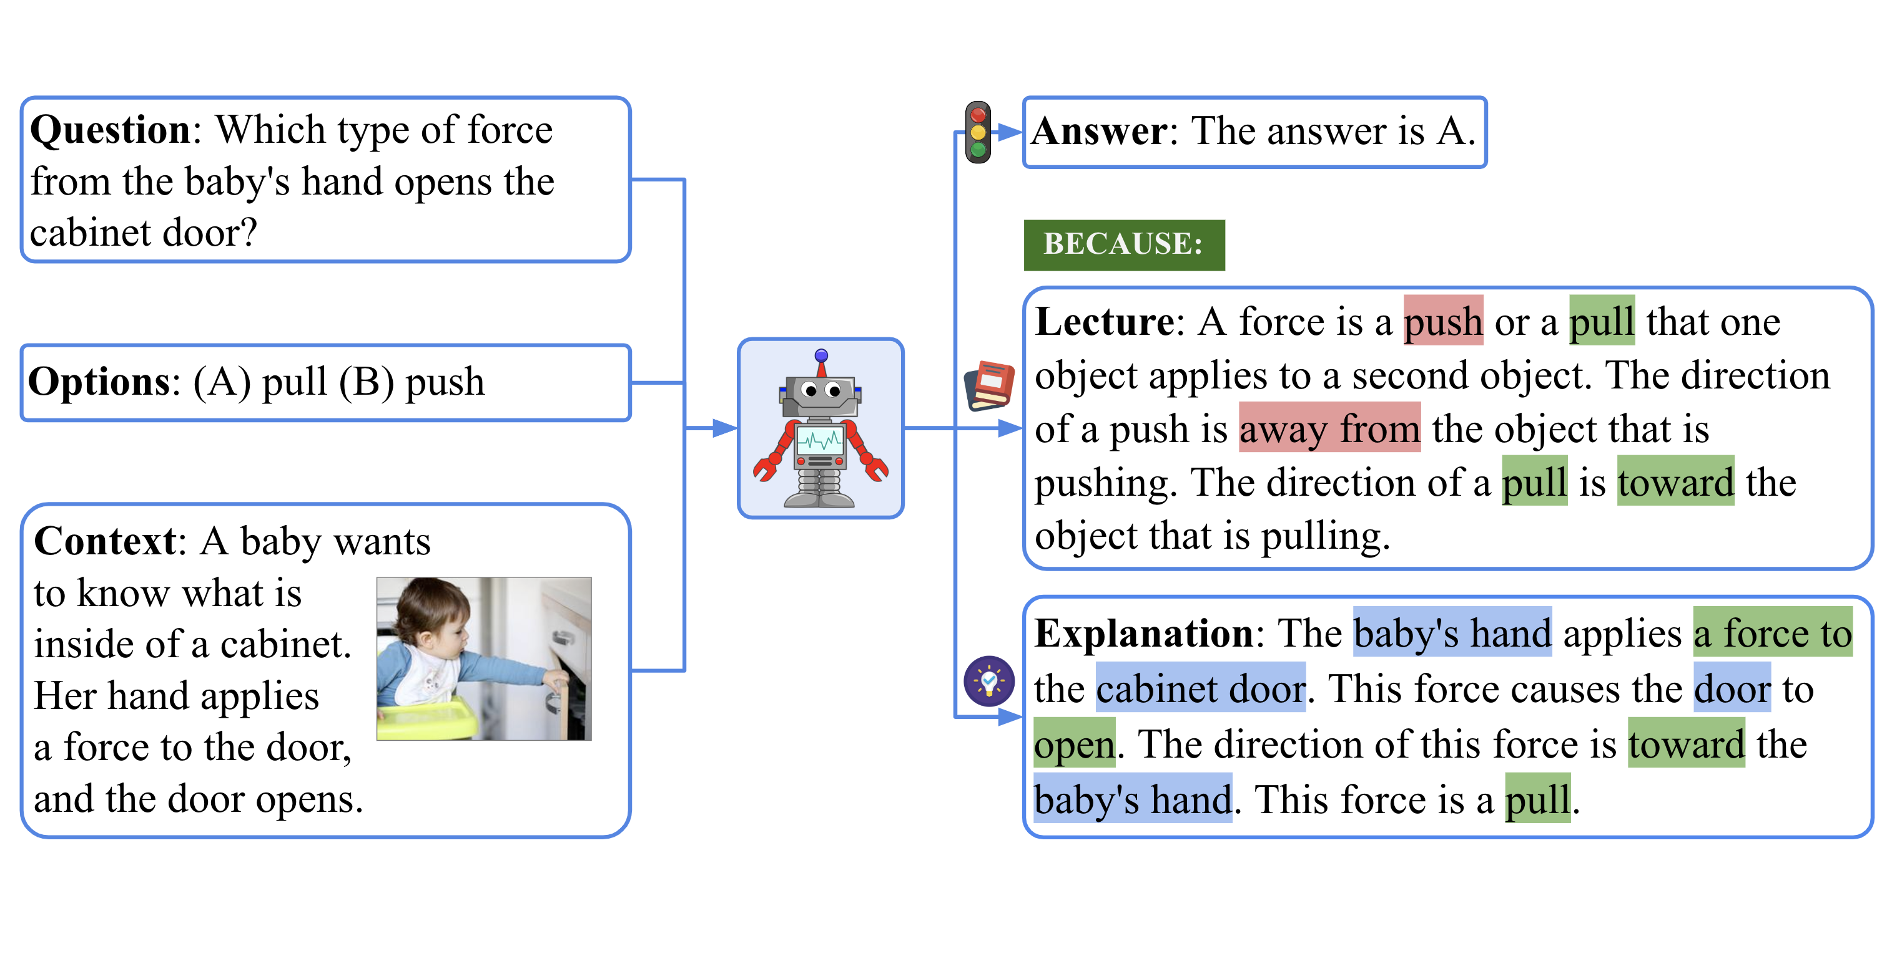
Low Resource Offline Multimodal Chatbot for ScienceQA
Team BOTZZ 🤖
David Liu
Jazmin Guo
Agrima Bansal
Shihao Xiong
Vansh Pruthi

Slide 2
Motivation and Problem Statement
1) Problem 2) Significance 3) Gap 4) Objective

Slide 3
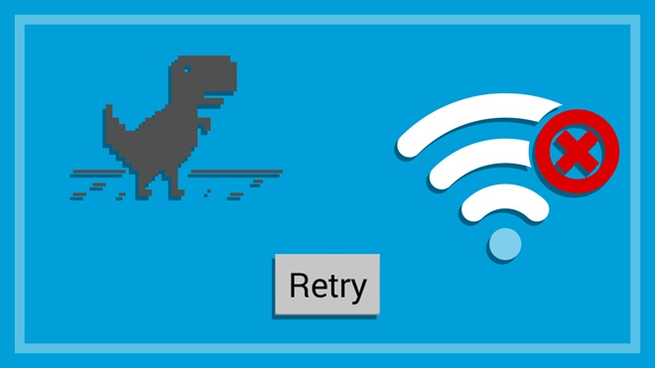
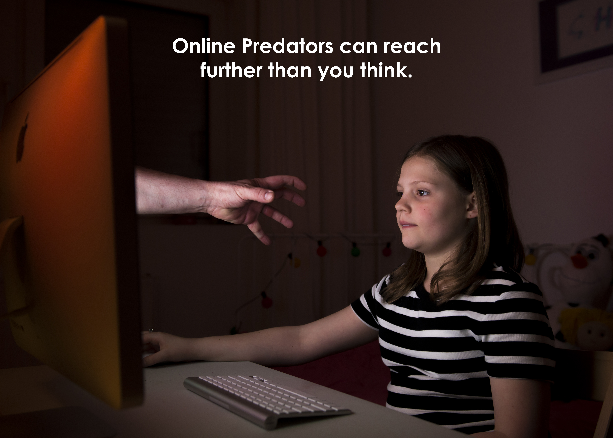
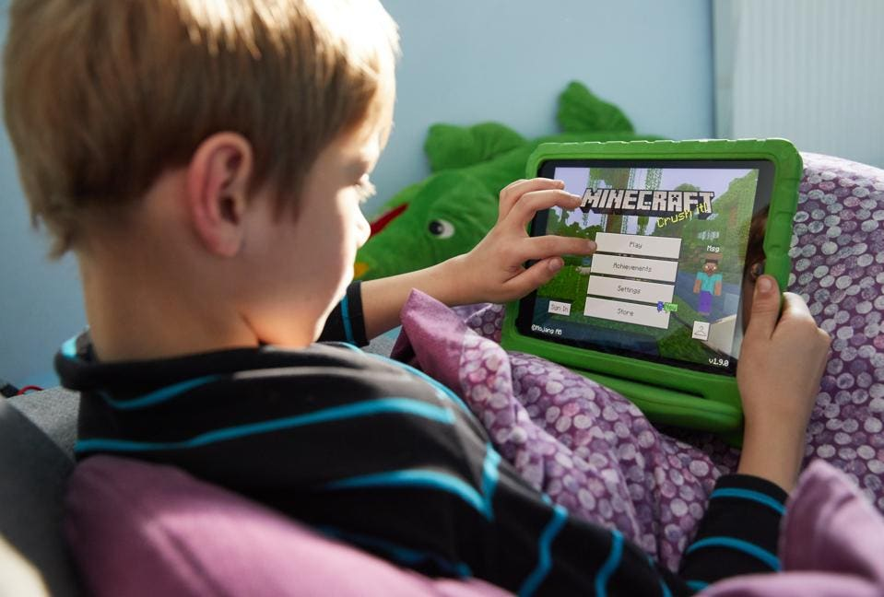
Motivation (1. problem)
Reliance on internet-based resources is not always feasible or desirable due to:
Connectivity issues
Privacy and safety concerns
Distractions

Slide 4
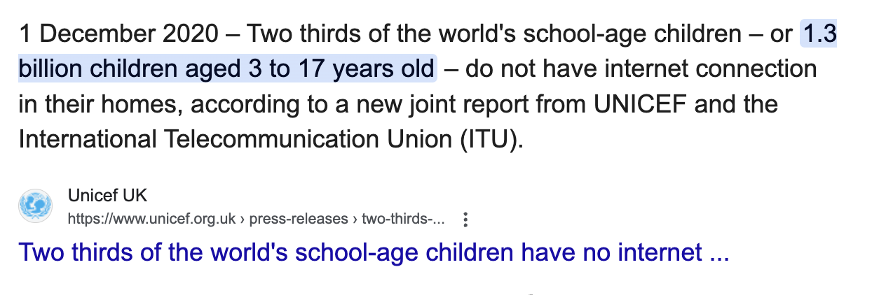
Motivation (2. significance)
Providing a free, accessible (low resource) and offline science learning tool can improve safety and educational equity.

Slide 5
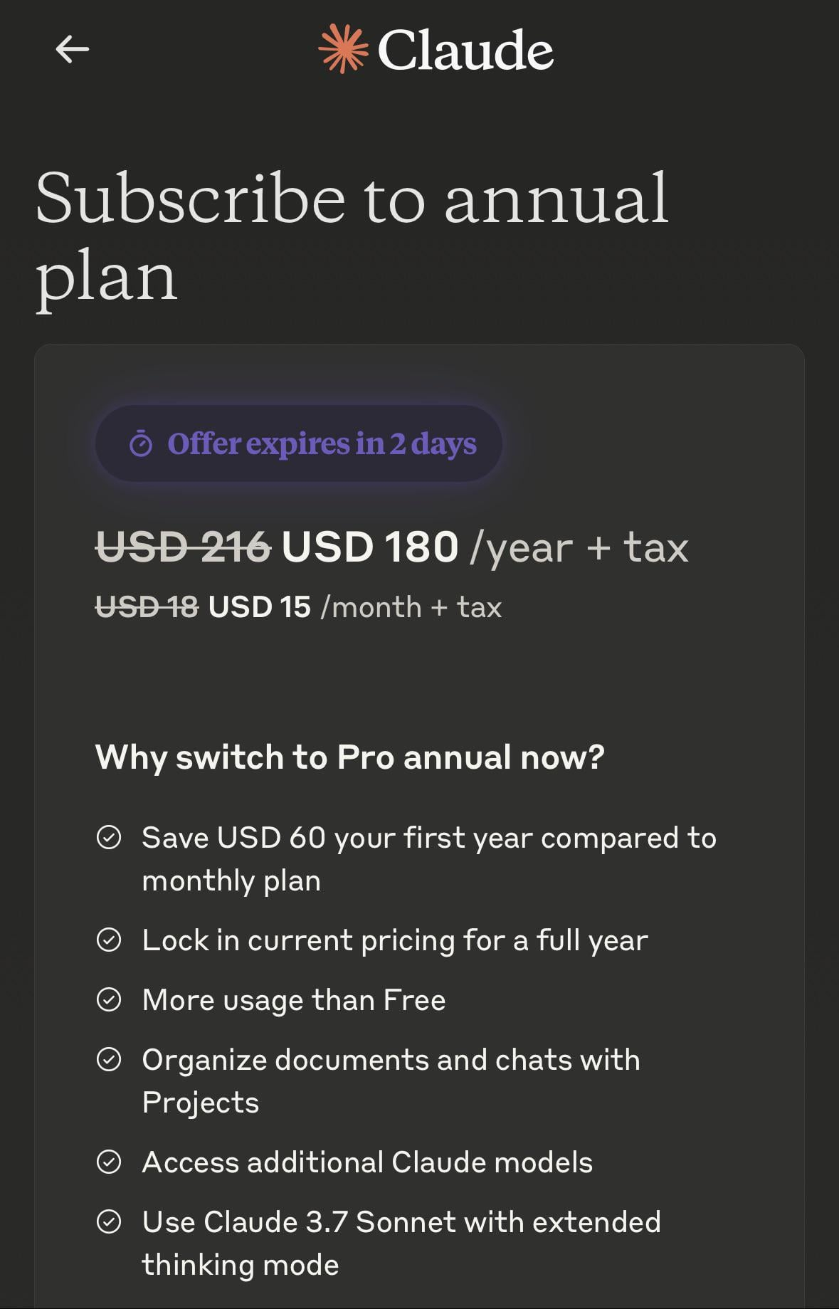
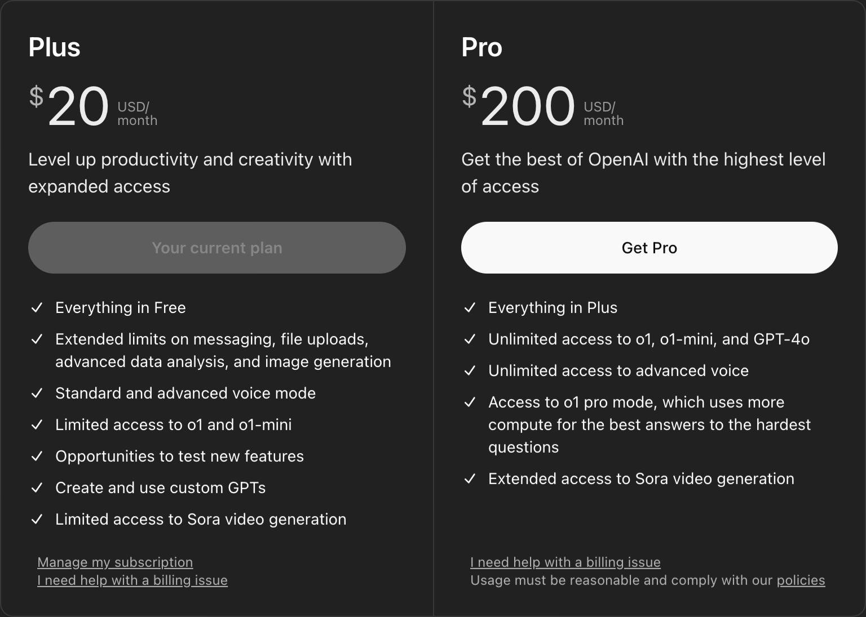
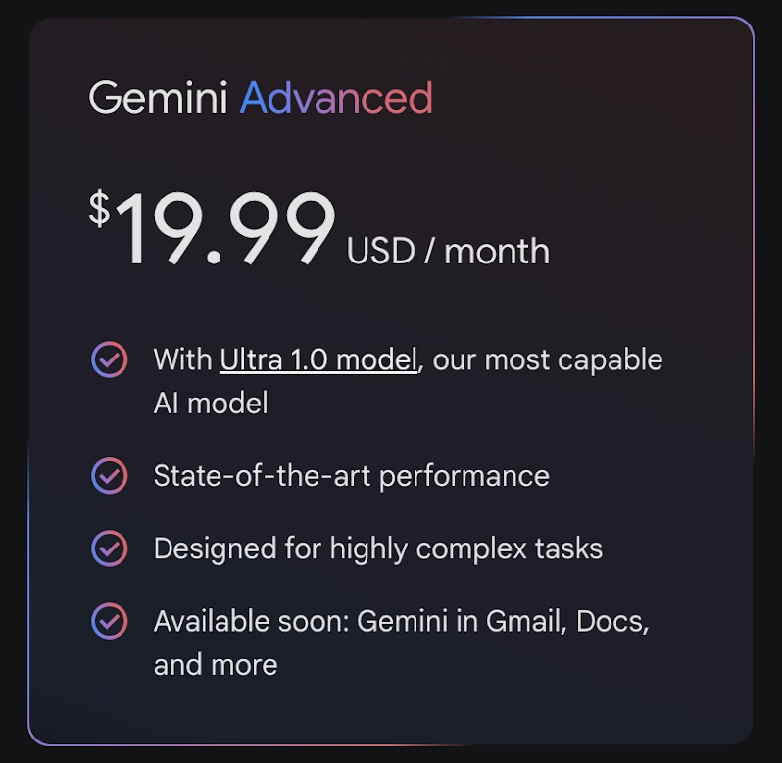
Motivation (3. Gap)
There is a lack of specialised science chatbot that run efficiently and entirely offline on personal devices like laptops or mobile phones. While online proprietary state-of-the-art chatbots exist (such as ChatGPT), they rely on:
Billed APIs
Data collections
Constant internet connectivity.

Slide 6



Motivation (4. objective)
To develop a chatbot utilising a low resource open source LLM model (Gemma-3-4B-instruction-tuned) that operates completely offline on user devices. Low computational cost
High accuracy

Slide 7
Literature Review

Slide 8
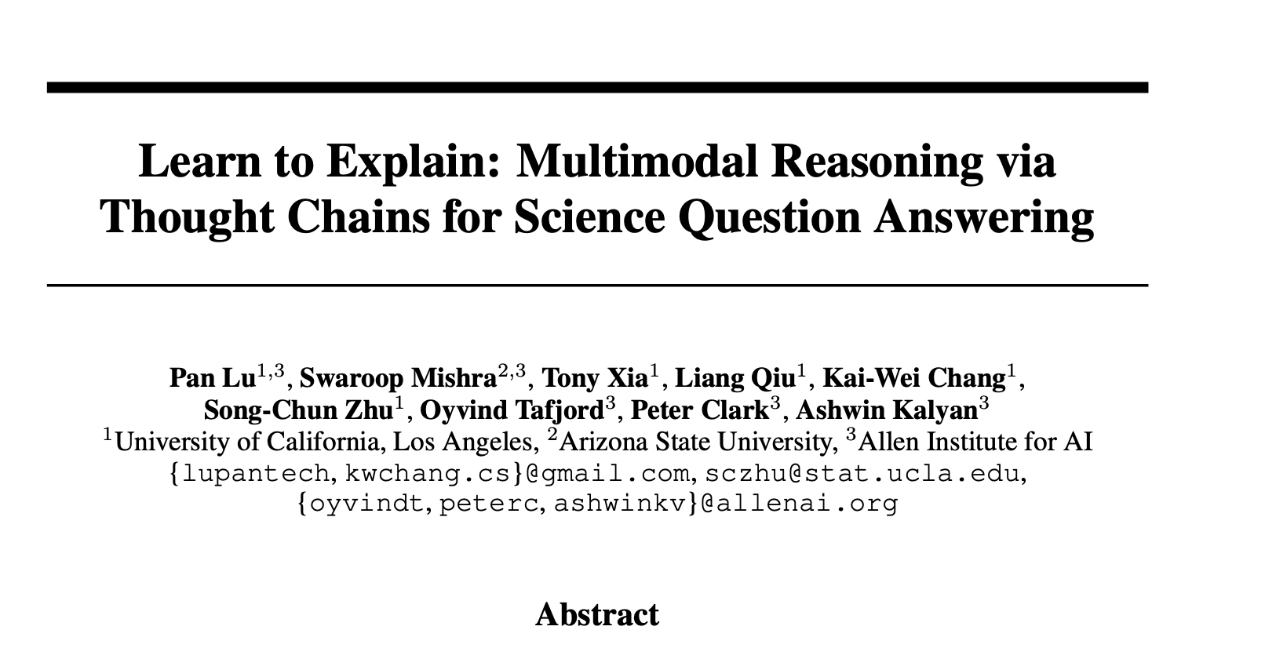
Literature Review
Introduce ScienceQA:A large-scale dataset with
questions from science curricula
When a question is enriched with Chain-of-Thought (CoT) reasoning we see an improvement in accuracy
Our project uses SeienceQA dataset and CoT prompts.
Model and prompt type | Accuracy
UnifiedQA with zero-shot | 70.12%
GPT-3 with zero-shot | 74.04%
UnifiedQA with CoT | 74.11 (3.99↑)
GPT-3with CoT | 75.17 (1.20↑)

Slide 9
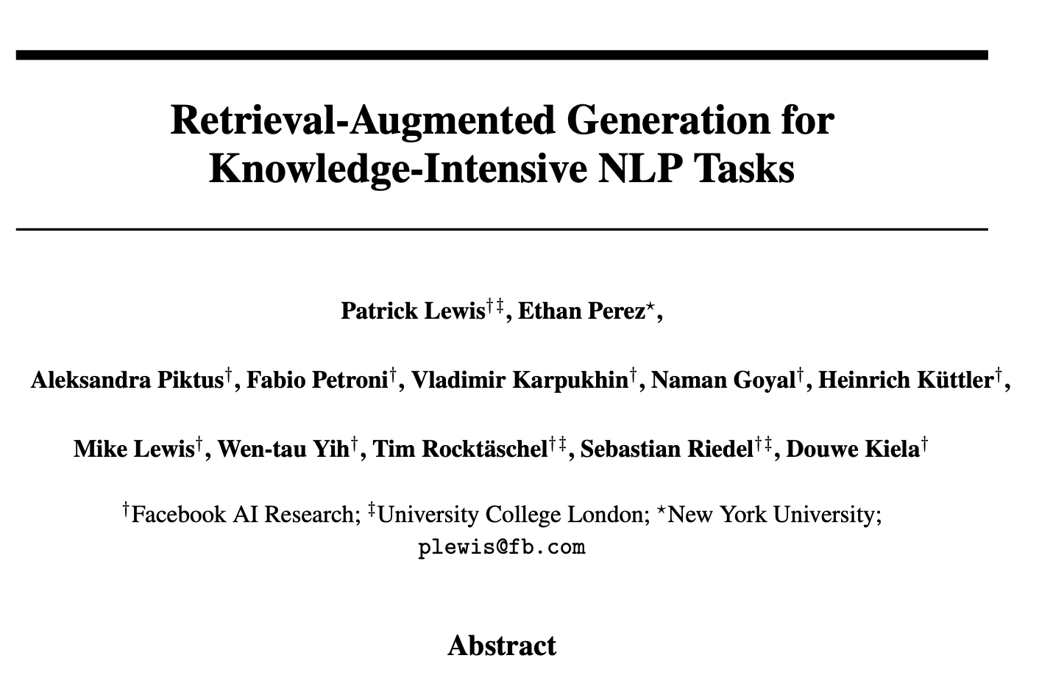
Literature Review
Introduce Retreival-Augmented Generation (RAG):
A hybrid architecture that combines the strengths of
parametric memory with non-parametric memory
This help to:
Improve factual accuracy and adaptability
Generated more compatible and flexible information
We are using retrieval (ChromaDB) to bring in relevant
lecture notes

Slide 10
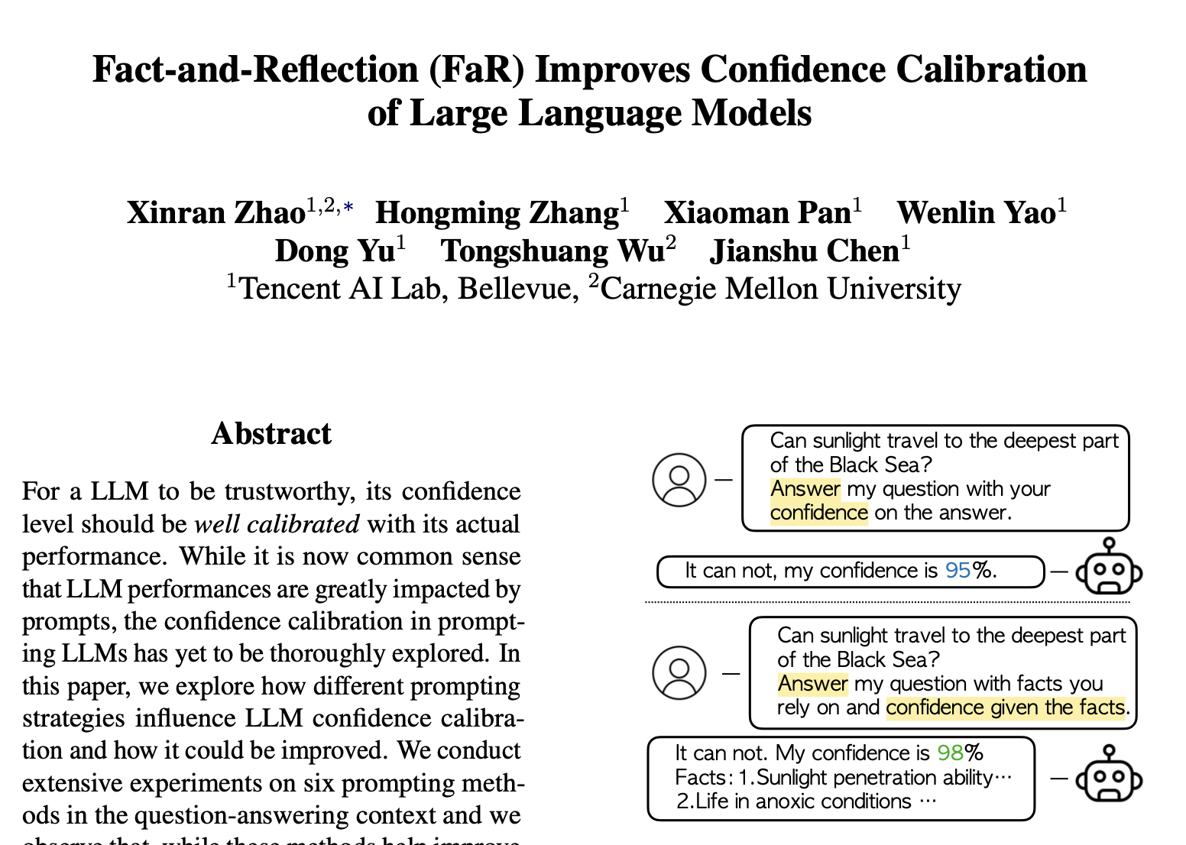
Literature Review
Introduce a prompting technique: Fact-and-Reflection (FaR)
The technique split the process into
1. Fact generation: Model recall the relevant knowledge
2. Reflection: Model reasons base on the facts
This help to:
1. Avoid overconfidence and express uncertainty
2. Improve confidence that match the actual correctness
3. Get more trustworthy confidence estimates

Slide 11
The ScienceQA Dataset
Presenters: Agrima Bansal (z5591215)

Slide 12
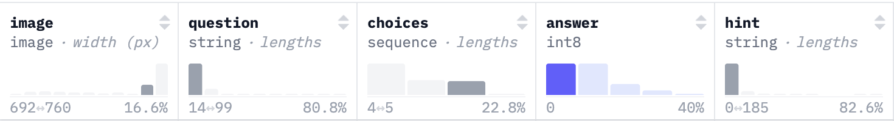
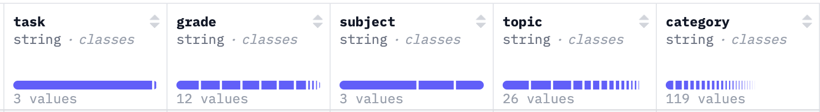
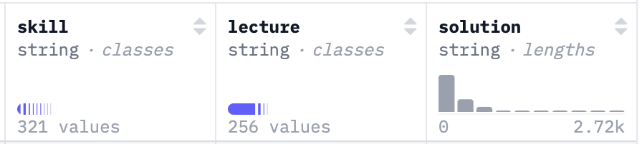
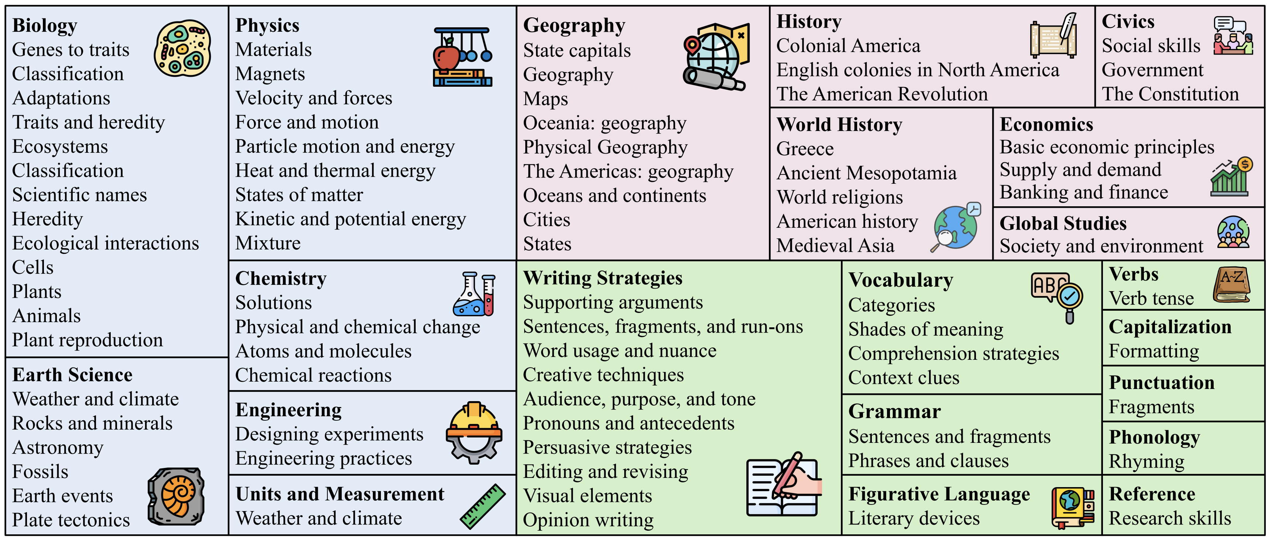
Dataset
ScienceQA Dataset
The top image shows all the different fields in the dataset.
Bottom image shows all the different topics and categories that the questions in the dataset cover
This level of variety makes the ScienceQA dataset especially valuable for building general-purpose educational AI systems, or for specialized models focusing on specific school subjects.

Slide 13
Dataset
Basic example of how the fields/metadata in the dataset are used

Slide 14
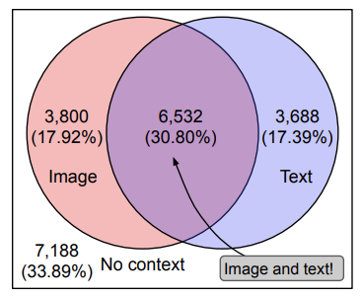
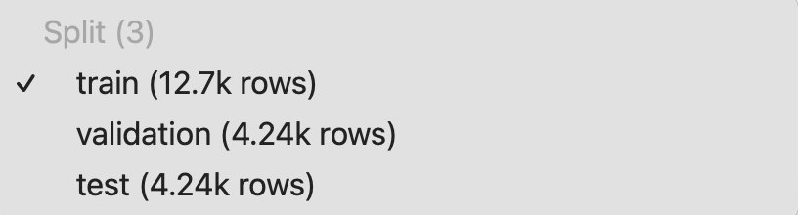
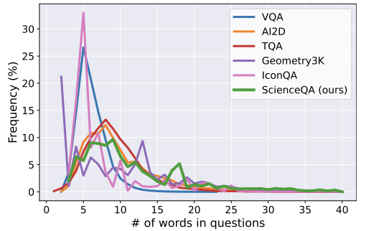
Dataset
Data Set Split
The dataset has ~21K questions that are randomly split into training, validation, and test splits with a ratio of 60:20:20.
In ScienceQA, (48.7%) have an image context, (48.2%) have a text context, and (30.8%) have both.
Sometimes, the model is given a lot of information from multiple sources, while at other times, the only source of information is the question itself.

Slide 15
Methods

Slide 16
Methods
1. Experimental Setup & Rationale
Objective: Improve the performance (accuracy and efficiency) of the model with different methods.
Dataset: ScienceQA
Platform: Google Colab
2. Main Methods
Fine-tuning
RAG(Retrieval Augmented Generation)

Slide 17
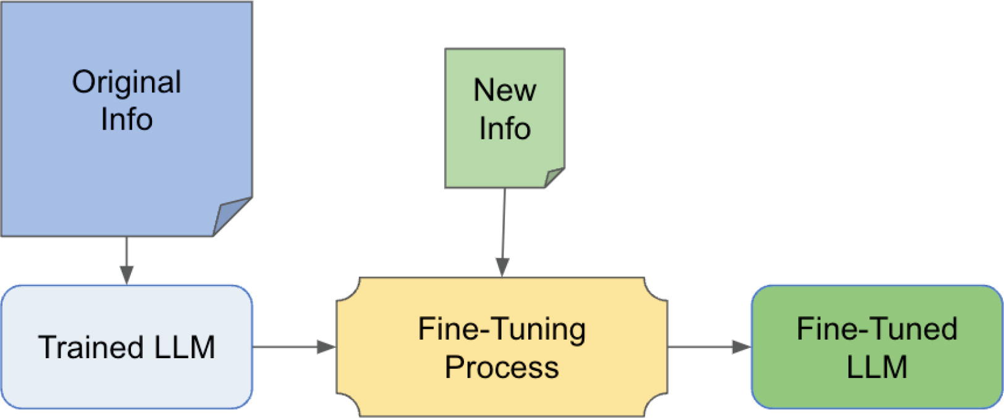
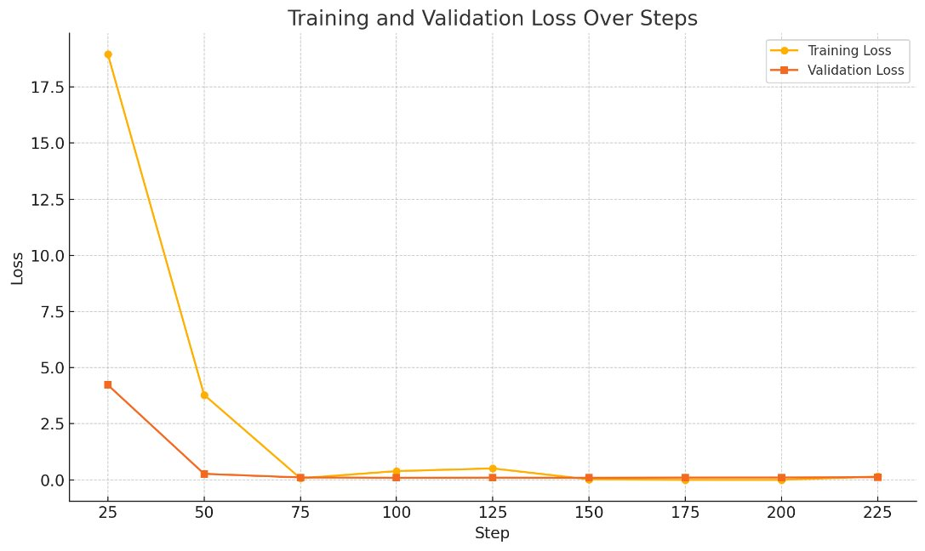
Fine-tuning
Use the training and validation set of the data
Format the data with labels (supervised)
PEFT (parameter-efficient fine-tuning) library by Hugging Face
LoRA (low-rank adaption)
Difficulties:
Passing text and image (multimodal input) to be tokenised and trained
Drawback:
Resource intensive -> not ideal for minor information updates
Notes:
Focuses on reduing the number fo aprameters that reduces trainig time

Slide 18
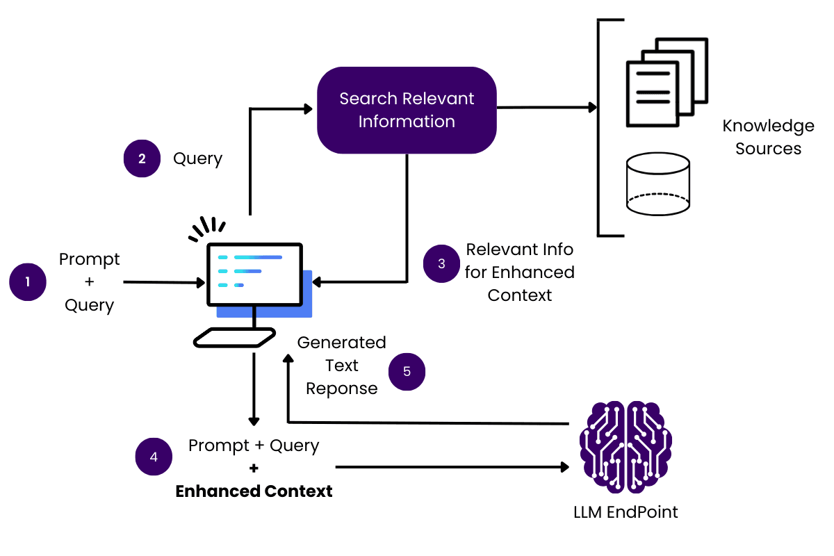
RAG (Retrieval Augmented Generation)
Definition: RAG a technique that enhances the accuracy and relevance of Large Language Models by incorporating external knowledge sources
User query
Retriever (via vector DB like ChromaDB
Converts into embeddings
Finds top-k relevant documents based on similarity
Augmented prompt
Retrieved documents+ original question are passed to LLM
Generator:
The model (e.g. GPT4o mini) generated a context aware answer.

Slide 19
RAG (Retrieval Augmented Generation)
Sentence-transformers model
all-MiniLM-L12-v2
maps sentences & paragraphs to a 384 dimensional dense vector space and can be used for tasks like clustering or semantic search.
Vector DB
ChromaDB
Stores the vectors
Retrieve based on vector similarity and metadata

Slide 20
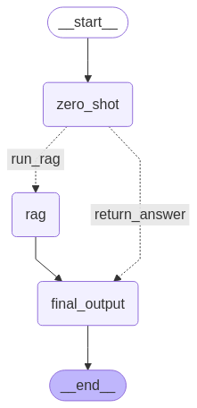

Integration of methods with Langgraph
Use model’s zero shot confidence score to determine if langgraph is need
High confidence -> return zero shot response
Low confidence -> run RAG

Slide 21
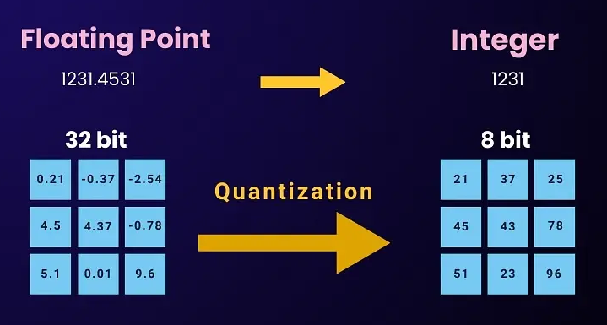
Quantization
Load the model with 8-bit integer
Quantization is a compression technique that involves mapping high precision values to a lower precision one
Improves efficiency on consumer-grade hardware

Slide 22
Results

Slide 23
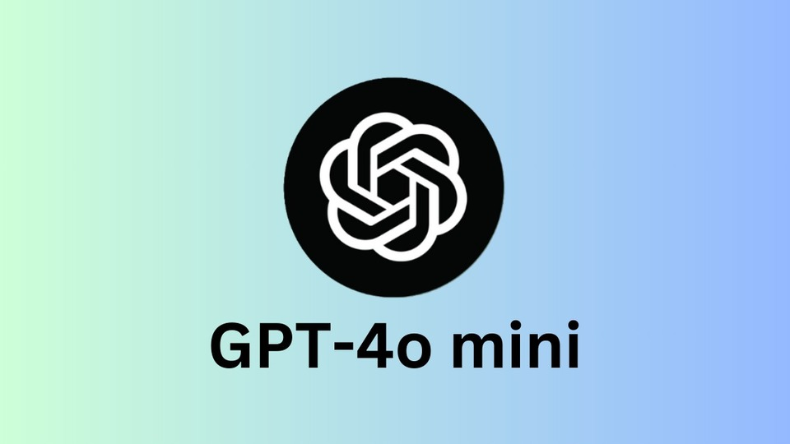
Using a subset of the data
After initial testing with 4o-mini (minimal prompting) we extracted a subset of the training dataset which contained 490 questions that 4o-mini got wrong. This is 12% of the training set.
We used this subset (the ”difficult” questions) to test various methods.

Slide 24
Results (no fine tuning, zero-shot vs RAG)
Model Name | Accuracy (on “difficult” questions subset size=490)
GPT-4o | 49.28%
Gemini-2.0-Flash | 55.21%
Gemini-2.0-Flash (with RAG #1) | 60.82%
Gemini-2.0-Flash (with RAG #2) | 57.96%
Gemini-2.0-Flash-Lite | 56.03%
Gemini-2.0-Flash-Lite (with RAG #1) | 58.75%
Gemini-2.0-Flash-Lite (with RAG #2) | 58.78%
RAG method # | K (retrievals) | Embedding Method | VectorDB Size
1 | 1 | text-embedding-3-large | 12726
2 | 1 | sentence-transformers/all-MiniLM-L12-v2 | 234 (deleted duplicates)

Slide 25
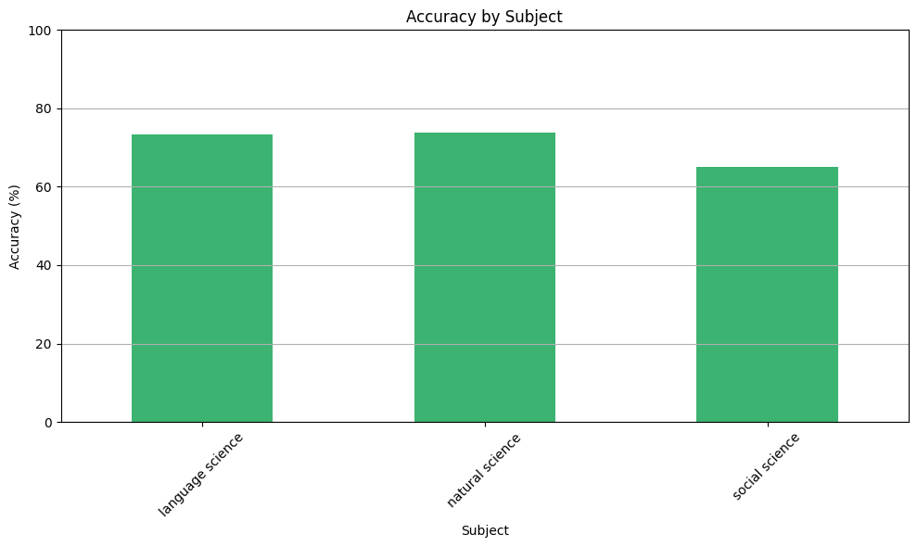
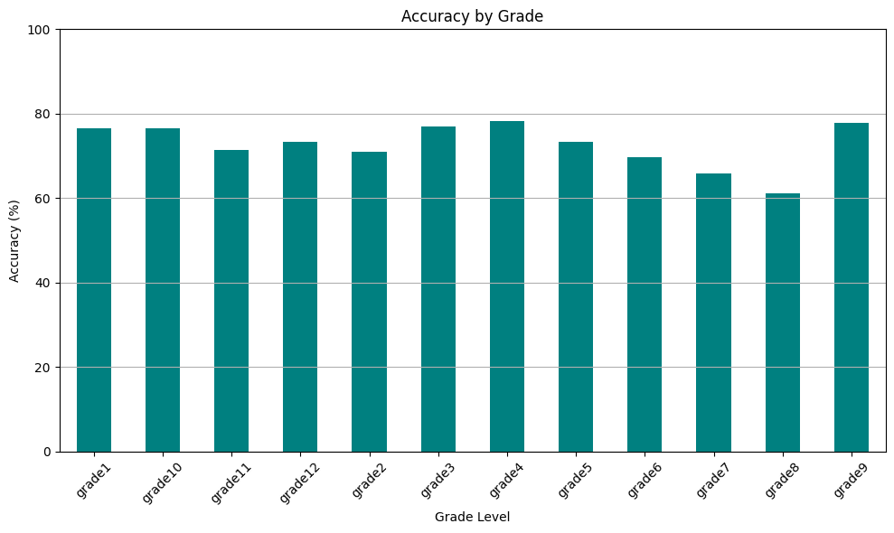
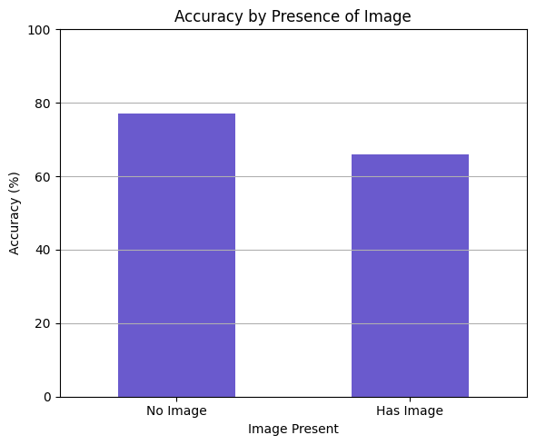
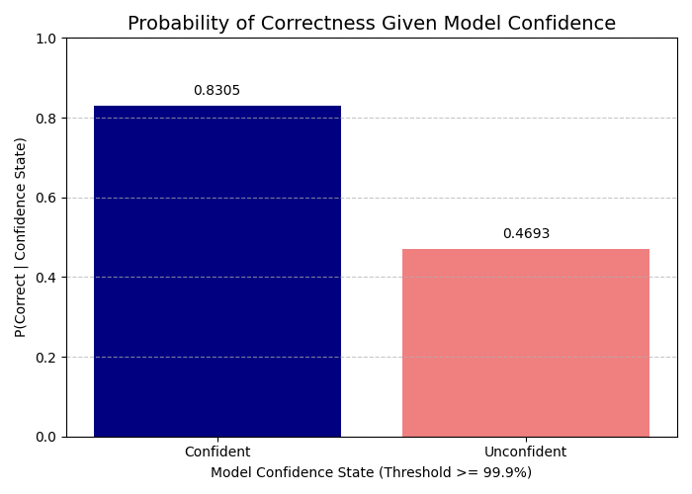
Data Analysis (Using gemma-3-4b it with minimal prompting)

Slide 26
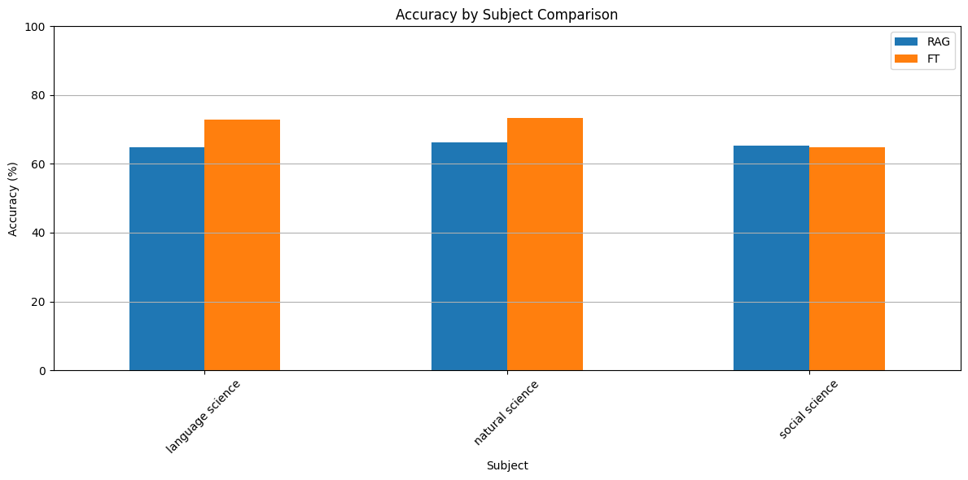
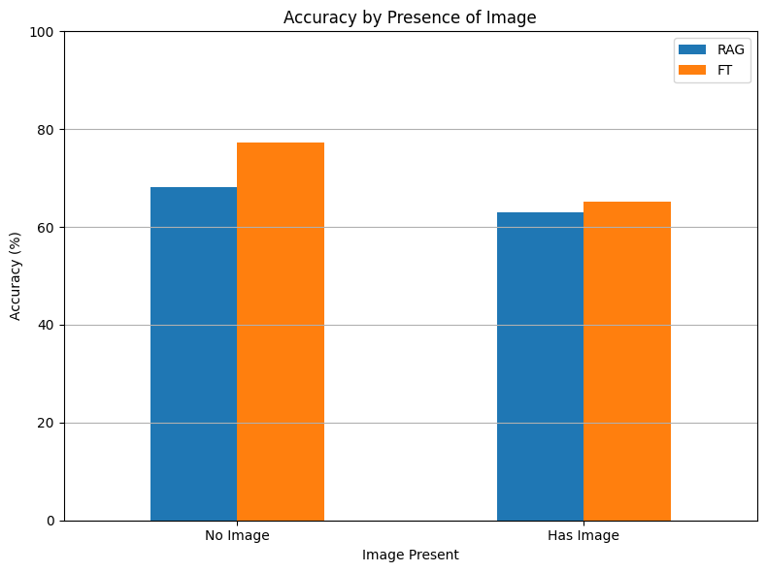
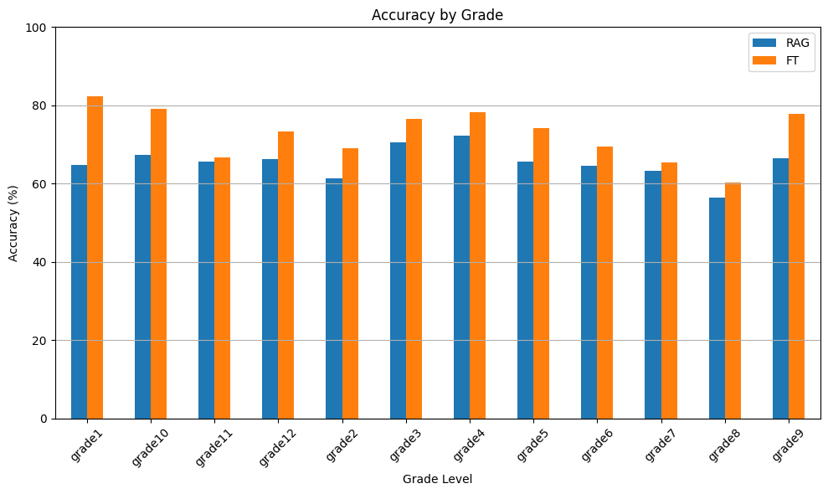
Results – RAG vs Fine tuned
Model Name | Accuracy
RAG | 65.64%
Fine Tuned | 71.52%

Slide 27
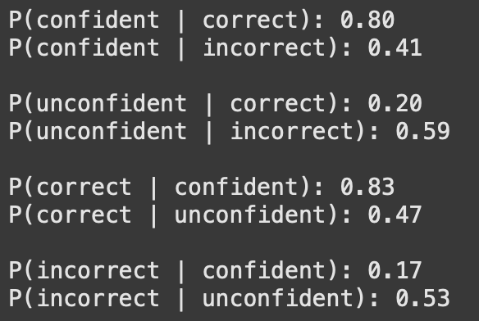
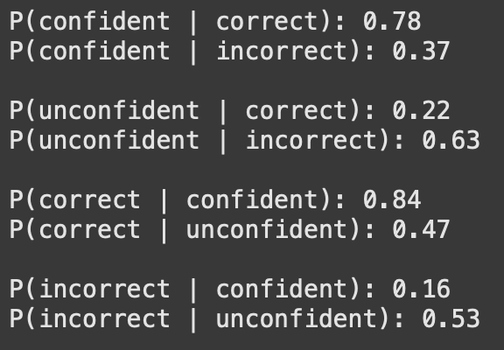
Data Analysis
Found a correlation between confidence and accuracy.
When >99.9% confident, accuracy is Base : 83%, FT : 84%
When <99.9% confident, accuracy is Base : 47%, FT : 47%
Gemma 4B it Base model
Confident threshold: confidence>0.999
Gemma 4B it Fine Tuned
Confident threshold: confidence>0.999

Slide 28
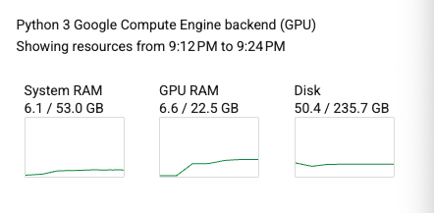
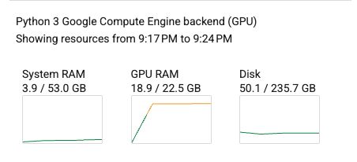
RAM usage quantized vs Full Size
Gemma 4B quantized
Gemma 4B full size

Slide 29
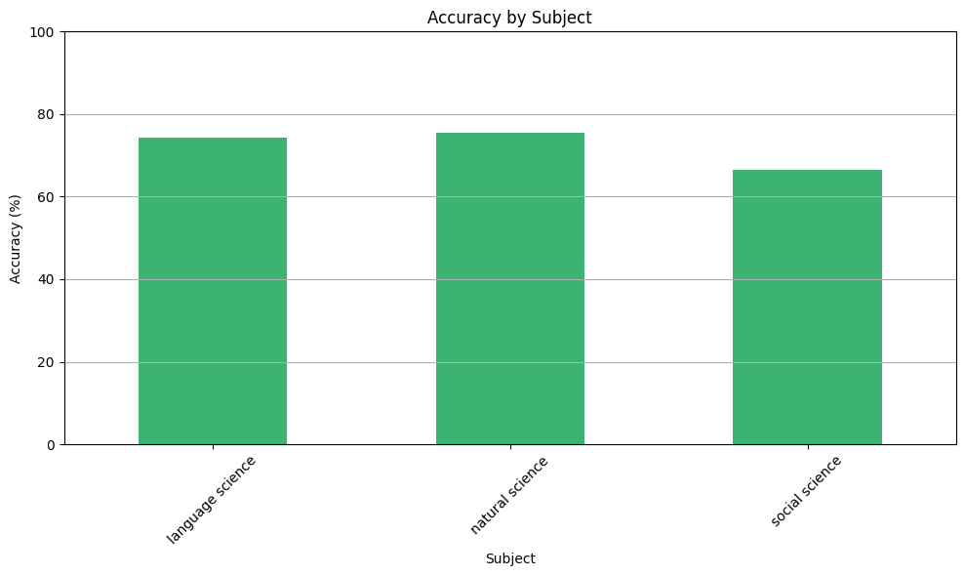
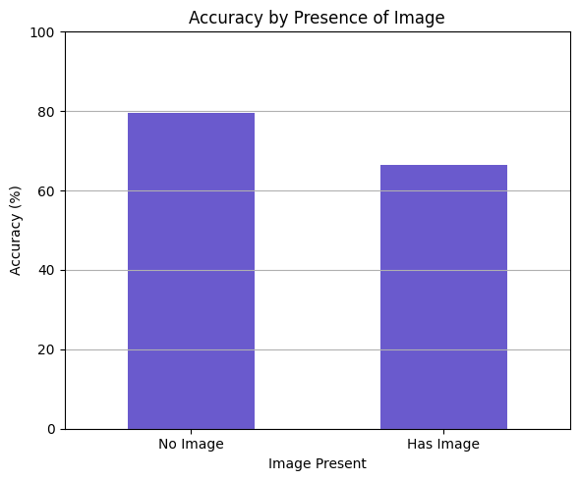
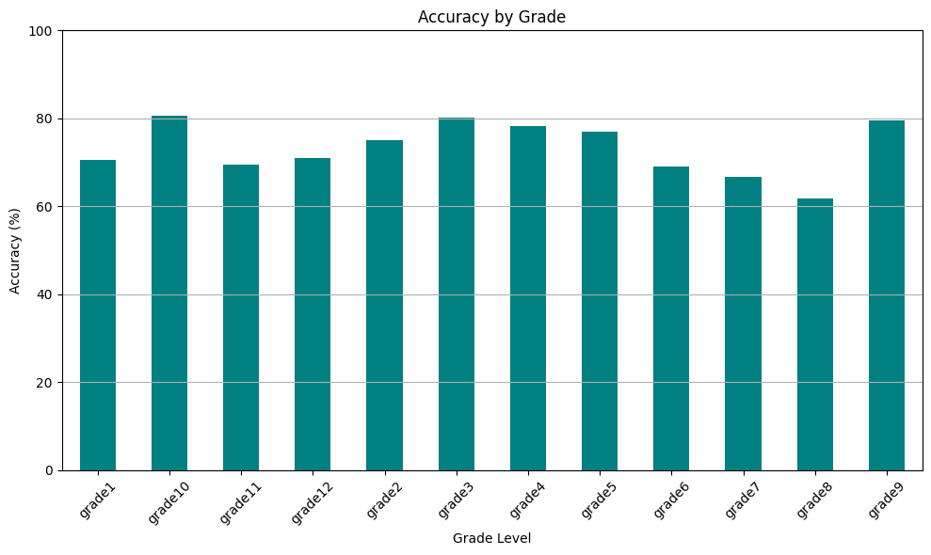
Mixed Method
Model Name | Accuracy
Mixed Quantised | 73.31%

Slide 30
Gemma 3 Variant | Accuracy on test set
Fine tuned mixed methods quantised | 73.31% (0.10 ↑)
Base model zero shot quantized | 73.21%

Slide 31
Discussion and Conclusion

Slide 32
Discussion and Conclusion
Gemma 3-4b performed significantly worse with RAG
Small models like Gemma 3–4B can’t handle long retrieved documents effectively
Small models are more affected by minor changes in how prompts and context are phrased
Quality of the prompt can significantly impact the output
RAG is a contingency for when the model has low confidence
Quantising the data reduces the RAM usage (makes it computationally less expensive)
Our Fine Tuning did not improve the model's performance by much.

